Slide 1
Changes With the New 2012 Life Safety Code
Presented by:
Brad Keyes, CHSP
Senior Consultant
Keyes Life Safety Compliance, LLC

Slide 2
Changes to Life Safety Compliance
Healthcare leaders will have to deal with many changes in Life Safety compliance when the 2012 edition of the Life Safety Code (LSC) is finally adopted by the Centers for Medicare & Medicaid Services (CMS)
The changes are an accumulation from revisions to the 2003, 2006, 2009 and the 2012 editions

Slide 3
Changes to Life Safety Compliance
The following presentation is not a complete list of all the changes, but the common ones that most likely will affect operations for a healthcare facility
All references to the Life Safety Code are to the 2012 edition

Slide 4
The Last Time…
The last time a change in the edition of the Life Safety Code was made, it was a significant event. CMS adopted the 2000 edition on March 11, 2003. Previously, they had been on the 1985 edition, which was horrible.

Slide 5
The Last Time…
The Joint Commission (TJC) had adopted some new editions as they were published, but CMS did not. This created confusion and frustration as many hospitals took advantage of the exceptions in the LSC edition that TJC enforced, which were not in the 1985 edition. This resulted hospitals being in compliance with Joint Commission, but not with CMS.

Slide 6
The Last Time…
Joint Commission and CMS were not on the same edition until March, 2003, but they have been ever since. Now that Joint Commission receives their deemed status from CMS (before 2009 they received it from Congress), they will always be on the same edition as CMS.

Slide 7
The Last Time…
Likewise, Healthcare Facilities Accreditation Program (HFAP) and Det Norske Veritas (DNV) are also on the same edition as CMS.
All of the Accreditation Organizations will move with CMS to the 2012 edition, when CMS finally adopts it. (No indication as to when…).

Slide 8
The Last Time…
Why does it take so long to adopt a new edition of the LSC?
The Administrative Procedure Act of 1946 requires federal agencies to follow specific rule-making procedures when they want to make changes to their rules.

Slide 9
The Last Time…
Any change in the rules must have proper due diligence conducted on the estimated cost involving the change. CMS must also issue a proposed rule, which they did in April, 2014, and then allow the public to make comments.
CMS will review all of the comments submitted and then issue a final rule.

Slide 10
The New 2012 LSC…
Let’s take a look at the changes you will find when the new 2012 LSC is finally adopted…

Slide 11
Openings in Exit Enclosures
Currently, the 2000 edition of the Life Safety Code does not allow any openings (entrances to rooms) to unoccupied rooms in exit enclosures (stairwells or exit passageways).

Slide 12
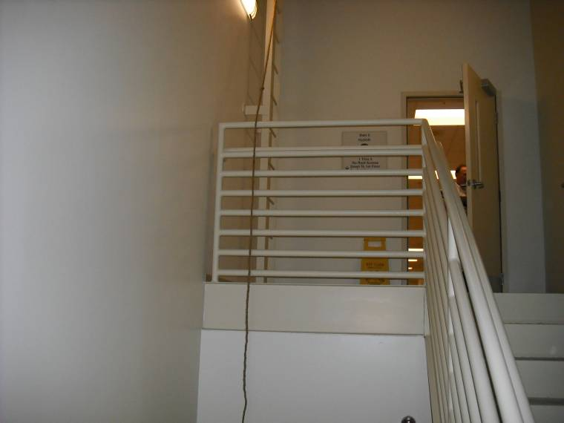
Openings in Exit Enclosures
That means a door to a mechanical room at the top of a stairwell was not permitted without a vestibule between the stairwell and the mechanical room.

Slide 13
Openings in Exit Enclosures
Section 7.1.3.2.1 (9) now permits openings (doors) to non-occupied mechanical rooms provided:
It is an existing opening
It is a properly fire rated assembly
No fuel-fired equipment in the room
The room does not contain storage of combustibles
The entire building is fully protected with automatic sprinklers

Slide 14
Openings in Exit Enclosures
Section 7.1.3.2.1 (10) also limits the penetrations, such as pipes and conduits, in an exit enclosure, but now they have allowed the following additional penetrations:
Existing penetrations that are properly fire-stopped
Penetrations for fire alarm circuits (even circuits that do not serve the exit enclosure), provided they are in metal conduit and the penetrations are properly fire-stopped

Slide 15
Action Required to Comply:
Make sure your building is fully sprinklered
Prepare to prove the dates of the construction for the condition
Clean out all the combustible storage that’s accumulated over the years

Slide 16
Electrically Locked Doors
Previously there were three situations where you can lock doors in the path of egress:
Clinical needs
Delayed egress
Access control
Now, there will be a fourth situation and it changes everything…

Slide 17
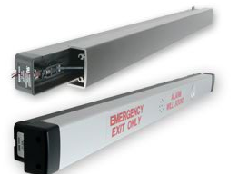
Electrically Locked Doors
Section 7.2.1.5.6 will now allow doors in the path of egress to be ‘electrically’ locked if equipped with listed hardware and meets the following conditions:
The door release hardware (crash bar) is affixed to the door leaf- (This means a wall-mounted ‘Push to Exit’ button is not sufficient)
The door release hardware must be obvious on how it operates and readily operates in the direction of egress-
(Continued)

Slide 18
Electrically Locked Doors
Continued:
The door release hardware (crash bar) is capable of being operated with one hand in the direction of egress-
Operation of the door release hardware interrupts power directly to the electric lock and unlocks the door
Loss of power to the door release hardware automatically unlocks the door
Hardware must be appropriately listed in accordance with ANSI/UL 294 standard

Slide 19
Electrically Locked Doors
In essence, the Life Safety Code now considers electrically locked doors as a normal door assembly and does not consider it as a special locking arrangement
This has the effect of equating the electrically controlled lock to a traditional, mechanically latched or locked door.
Sections 18/19.2.2.2.1 allow for this arrangement in hospitals

Slide 20
Action Required to Comply:
Understand where this type of locking hardware applies
Does not allow lock release by key pad or card access systems

Slide 21
Dead-Bolt Locks
Sections 7.2.1.5.10 requires the releasing mechanism on the door shall open the door with no more than one operation.
Previously, this would mean that dead-bolt locks that are not an integral part of the latch-set, are not permitted.

Slide 22
Dead-Bolt Locks
A new section (7.2.1.5.10.6) allows two releasing operations will be permitted for existing hardware on a door serving an occupant load not exceeding three persons, provided the releasing mechanisms do not require simultaneous operations.

Slide 23
Action Required to Comply:
Can you prove the dates when the dead-bolt locks were applied?
Hardware must still have an obvious method of operation
Dead-bolt locks should not be keyed on both sides

Slide 24
Fire Door Testing and Inspection
Sections 7.2.1.15.2 and 8.3.3.1 require all fire doors to be inspected and tested (per NFPA 80)
The individual conducting the inspection must have knowledge and understanding of the operating components of the door being inspected

Slide 25
Fire Door Testing and Inspection
What qualifies the individual to have knowledge or understanding?
The LSC does not specify, but the authorities having jurisdiction (AHJs) will want to see how you determined that the designated individual is ‘knowledgeable and understands’ on door operations

Slide 26
Fire Door Testing and Inspection
Some of the requirements for each fire door inspection and testing:
Must be conducted annually with written records that are dated and signed
Visually inspect doors for any damage or missing parts
Operate the door fully to ensure door will close and function properly
Inspect door hardware and replace all defective items
Tin-clad doors must be inspected for dry rot of the wood core

Slide 27
Fire Door Testing and Inspection
Additional requirements for each fire door inspection and testing:
No holes or breaks exist in the surfaces of the door or frame
Glazing and glazing beads are intact and secure
Clearance between the bottom of the door and the threshold cannot exceed ¾ inch, unless the bottom of the door is mounted more than 38 inches above the floor, then the clearance is limited to 3/8 inch
Check to make sure the coordinator is operating correctly

Slide 28
Fire Door Testing and Inspection
Additional requirements for each fire door inspection and testing:
Make sure positive latching hardware secures the door in the closed position
Confirm that no field modifications have been made to the door or frame that would void the fire rating
Check door and rating label to ensure it is legible, and it is the proper rating for the barrier

Slide 29
Action Required to Comply:
Don’t wait until the last minute: Prepare in advance
If in-house, arrange for training or certification
If not in-house, identify a consultant
Identify the doors requiring inspection (its not all doors)
Create the format for the written report
Budget in advance; both for the initial inspection and the annual inspection
Don’t forget ILSM’s

Slide 30
Door Locks for Safety Needs
Let’s look at door locking arrangements, again…
The application of locks for ‘clinical needs’ was always confusing. It was always allowed for Psychiatric and Alzheimer’s units, but the AHJs could not always agree that these locks could be used in infant nurseries and pediatric units.

Slide 31
Door Locks for Safety Needs
Section 19.2.2.2.5.2 now allows doors to be locked for ‘safety needs’ frequently found in nurseries, pediatric and maternity units, provided:
Staff can readily unlock the doors at all times
A complete smoke detection system is installed in the locked space, or the locked doors can be remotely unlocked from a constantly attended location
The building is fully protected with sprinklers
The locks are electrical locks that fail safe on a power loss
Doors unlock on activation of smoke detectors or sprinklers

Slide 32
Action Required to Comply:
If contemplating changes take a fresh overall look at security needs
May work well with an infant abduction system
Building must be fully protected with sprinklers… Complete your sprinkler project now
Most nurse stations are not constantly attended

Slide 33
New Corridor Projection Requirements
Section 19.2.3.4 now allows:
Non-continuous projections on wall no more than 6 inches above the handrail height in corridors that are at least 6 feet wide
The 2000 edition did not have this allowance but it was permitted through the interpretation of the Tentative Interim Amendment (TIA) for Alcohol Based Hand-Rub (ABHR) dispensers

Slide 34
New Corridor Projection Requirements
The TIA for the 2000 edition had requirements on how far apart items mounted on the wall had to be
The 2012 edition did away with the distance requirements and only requires the items to be ‘non-continuous’

Slide 35
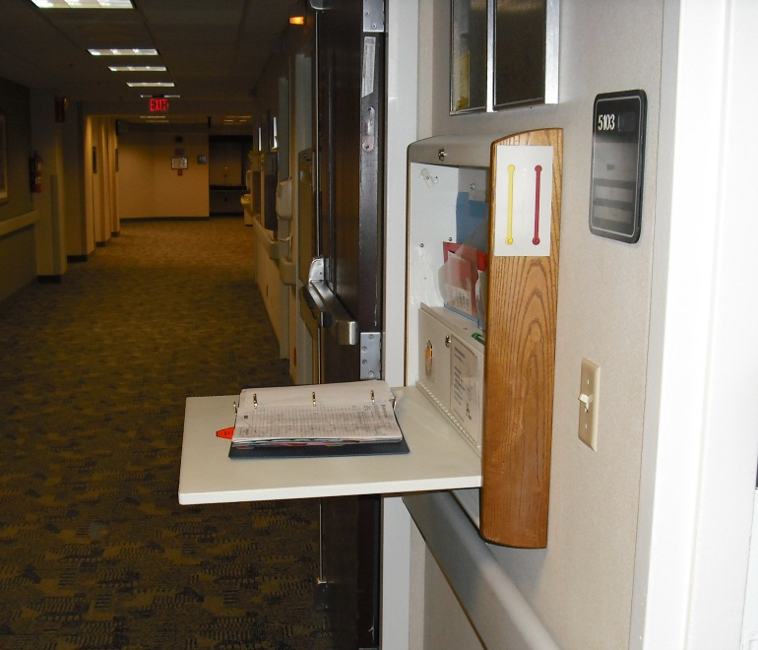
New Corridor Projection Requirements
The 2012 LSC will still require you to limit wall projections to no more than 6 inches, so images like these will still be a deficiency…

Slide 36
New Corridor Projection Requirements
But CMS has stated in their proposed rule to adopt the 2012 LSC that they will require hospitals to abide by the more restrictive 4 inch maximum corridor projection required by the Americans with Disabilities act (ADA)

Slide 37
Action Required to Comply:
Identify projections greater than four inches and resolve them proactively
Budget for changes accordingly
Look out for equipment in alcoves that project greater than four inches into the corridor

Slide 38
New Corridor Width Requirements
Section 19.2.3.4 now will allow certain wheeled equipment to project into the required width of the corridor, provided the following is in compliance:
The corridor is at least 8 feet wide
The clear width of the corridor is not reduced to less than 5 feet
There is a written fire safety plan and training program that address the relocation of the wheeled equipment during a fire

Slide 39
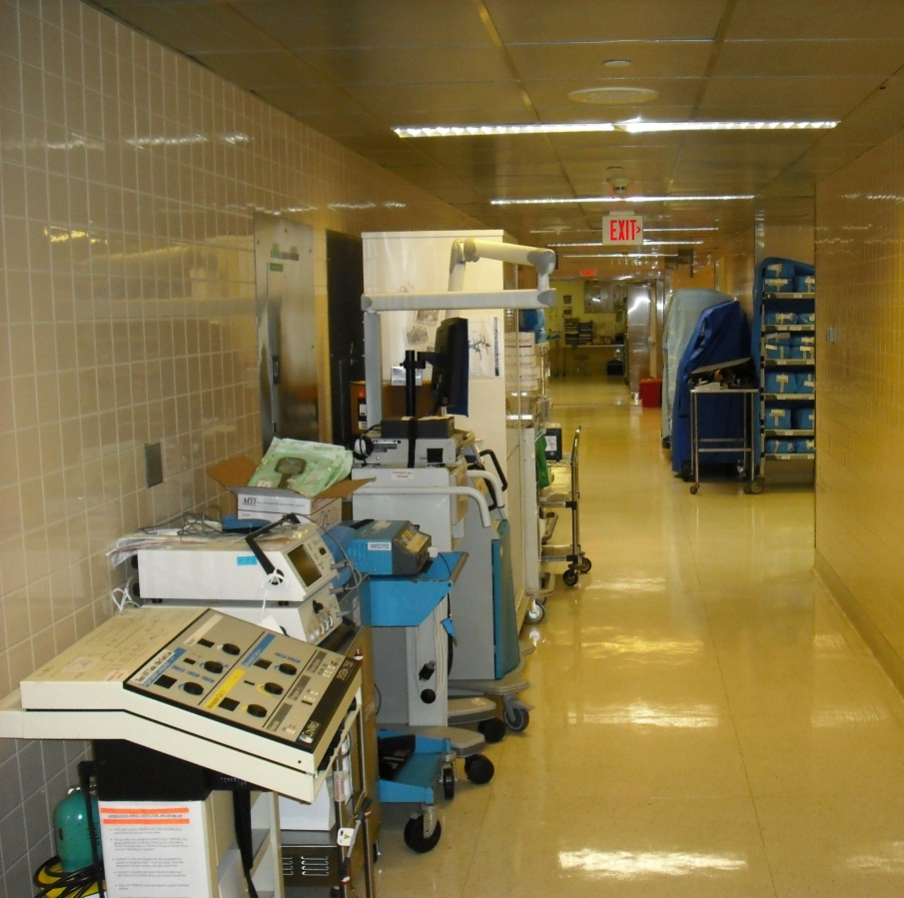
New Corridor Width Requirements
The permissible wheeled equipment is limited to the following:
Equipment and carts in use
Medical emergency equipment not in use
Patient lift and transport equipment

Slide 40
New Corridor Width Requirements
Examples of the permissible wheeled equipment are:
Food service carts in use
Housekeeping carts in use
Medication carts in use
Isolation carts (should be removed when not used)
Crash carts
Wheeled emergency medical equipment
Portable lift equipment
Transport equipment

Slide 41
New Corridor Width Requirements
Wheeled equipment that is not permitted:
Beds
Televisions
Commodes
Linen carts
Soiled linen hoppers
Trash containers
Desks
Chairs
Tables

Slide 42
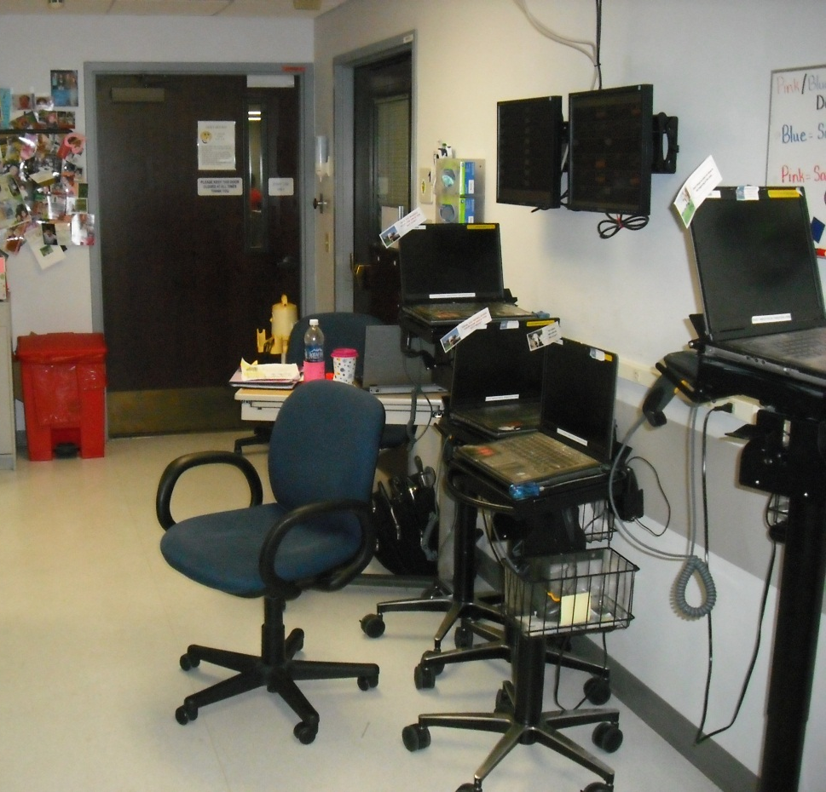
New Corridor Width Requirements
What about the ever-present Computers on Wheels (COWS)?
CMS, Joint Commission and HFAP are on record as saying computers on wheels will not be considered as medical emergency equipment

Slide 43
New Corridor Width Requirements
Section 19.2.3.4 permits fixed furniture in corridors that are at least 8 feet wide, provided that:
The fixed furniture is securely attached to the floor or wall
The fixed furniture does not reduce the clear, unobstructed width of the corridor to less than 6 feet
The fixed furniture is located only on one side of the corridor
The group of fixed furniture does not exceed 50 square feet

Slide 44
New Corridor Width Requirements
Additional fixed furniture provisions:
The groupings of fixed furniture are separated from each other by at least 10 feet
The fixed furniture is located so as not to obstruct access to building service equipment
Smoke compartment corridors are protected by smoke detectors, or the fixed furniture is arranged to allow direct supervision by staff
Smoke compartment must be protected by automatic sprinklers

Slide 45
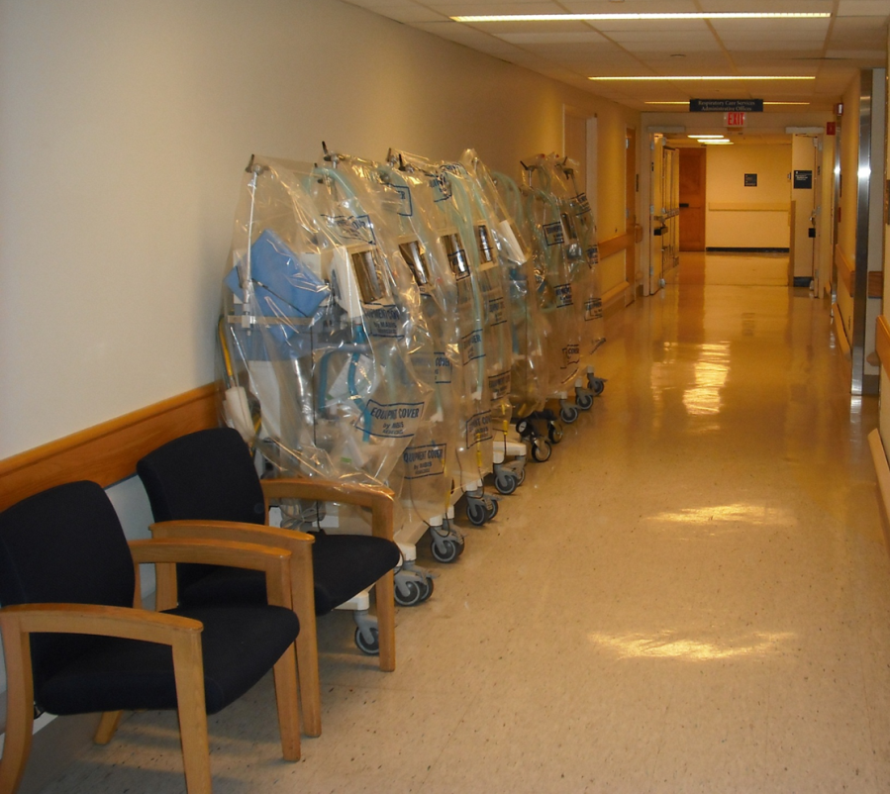
New Corridor Width Requirements
Be careful: Even with the new 2012 Life Safety Code, scenes like this will be a problem:
The medical equipment appears to be stored, which is not the intent of the Code
The chairs are not attached to the floor or wall

Slide 46
Action Required to Comply:
Regarding Wheeled Equipment…
There main difference from the current 2000 LSC is now wheeled emergency medical equipment not in use is permitted to be left in the corridor, along with portable lift equipment and patient transport equipment
Defining and limiting items to those allowed could be difficult in working with staff

Slide 47
Action Required to Comply:
Regarding Wheeled Equipment…
The written fire plan will require identifying where equipment goes during a fire. This takes some thought as it cannot be placed anywhere that would interfere with the required path of egress. Not having such locations is often the reason why things end up in the corridor in the first place, particularly in older hospitals
[Having a plan that states equipment will be placed in an empty patient room is not acceptable, since the possibility exists that all of the patient rooms may all be full.]

Slide 48
Action Required to Comply:
Regarding Wheeled Equipment…
Training will need to be extensive and on-going, and will need to be tailored to specific locations. A general policy will not address where to put things during a fire
Some thoughts should be given to the image projected if items in the corridor become numerous

Slide 49
Action Required to Comply:
Regarding Fixed Furniture…
In a hospital (as opposed to a long term care facility) fixed furniture in the corridor should be used for a clear program need; not as a matter of convenience
Where used for supplemental seating for waiting needs, consideration should be given to patient and family privacy needs, particularly in busy public corridors

Slide 50
Suites of Rooms
The 2012 edition has clarified many issues involving suites, and has a few changes that should be of some help to hospitals
Suites are only found in healthcare occupancies and ambulatory care occupancies. Only sleeping suites are found in healthcare occupancies.
A suite can be defined as one large room with many smaller rooms inside it

Slide 51
Suites of Rooms
Clarifications:
Suite perimeter walls and doors must meet the requirements for corridor walls and doors
Hazardous areas inside a non-sleeping suite do not have to be separated from the rest of the suite, if the entire suite is classified as a hazardous area (Labs)
Sterile surgical materials limited to a one-day supply in a sprinklered OR suite may be open to the rest of the suite without separation

Slide 52
Suites of Rooms
New changes, according to 19.2.5.7:
Sleeping suites may use a horizontal exit as one of their required exits
If two or more exit access doors are required from a suite, then one of the exit access doors may be to an exit enclosure or an exterior exit
Sleeping suites are required to have constant supervision by staff

Slide 53
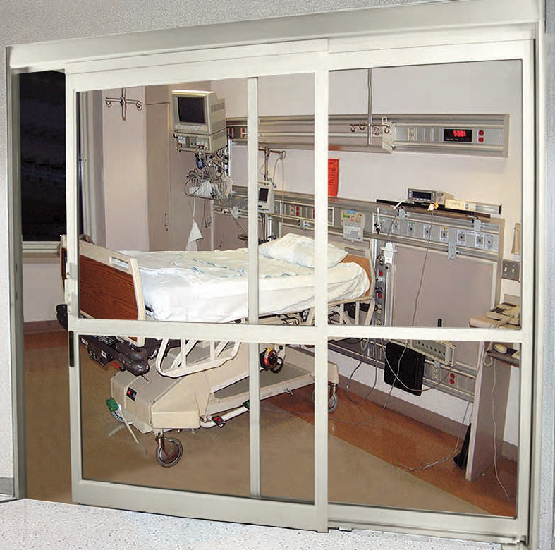
Suites of Rooms
New changes, according to 19.2.5.7:
Patient sleeping rooms inside a suite must allow direct supervision by staff, or the entire suite must have automatic smoke detection

Slide 54
Suites of Rooms
New changes, according to 19.2.5.7:
Where two exits are required from a suite, one of the paths of egress is permitted to be into an adjoining suite, provide the separation between the suites meet corridor wall and door requirements
The 100 foot travel distance limitation only applies to the first suite
(The travel distance limitation resets for the 2nd suite)

Slide 55
Suites of Rooms
New changes, according to 19.2.5.7:
Sleeping suites are limited to 5,000 ft²
Sleeping suites are limited to 7,500 ft² provided the following conditions apply:
The entire smoke compartment where the suite is located is protected with standard response sprinklers and smoke detector, or;
If the entire smoke compartment where the suite is located is protected with quick-response sprinklers, then smoke detectors are not required

Slide 56
Suites of Rooms
New changes, according to 19.2.5.7:
Sleeping suites are limited to 10,000 ft² provided:
The patient sleeping rooms are arranged for direct supervision by staff
The entire suite is covered by smoke detectors
The entire suite is protected with automatic sprinklers

Slide 57
Suites of Rooms
New changes, according to 19.2.5.7:
Non-sleeping suites must have an exit access to a corridor or to a horizontal exit
In non-sleeping suites, where two or more exit access doors are required, one of the exit access doors is permitted to an exit enclosure or exit door to the exterior

Slide 58
Suites of Rooms
New changes, according to 19.2.5.7:
In non-sleeping suites that require two means of egress, one of the means of egress is permitted to be into another suite, provided the separation between the suites complies with corridor wall and door requirements (The adjacent suite is not considered an intervening room)
Travel distances within a non-sleeping suite to an exit access door is 100 feet (No limitations for intervening rooms)

Slide 59
Action Required to Comply:
There are no real downsides to the new rules for suites of room
Take advantage of suites of rooms in your hospital. Many hospitals still do not clearly understand the benefits
Re-analyze your facility in light of the new rules to see if there are additional suites that could be created
Work with a design professional since suites affect egressing

Slide 60
Hazardous Areas
The Life Safety Code always had a ‘short-list’ of what a hazardous area is in a healthcare occupancy:
Boiler and fuel fired rooms
Central laundries larger than 100 ft²
Paint shops
Repair shops
Soiled linen rooms
Trash collection rooms
Storage room greater than 50 ft² containing combustibles
Laboratories containing flammables or combustibles in quantities less than ‘severe hazard’

Slide 61
Hazardous Areas
Here’s what changed for the 2012 edition, according to section 19.3.2.1.5:
Soiled linen rooms containing no more than 64 gallons of soiled linen are not considered hazardous
Trash collection rooms are now defined as ‘Rooms with collected trash’ and are not considered hazardous if they contain no more than 64 gallons of trash

Slide 62
Hazardous Areas
Additional changes involving hazardous rooms:
Gift shops have been removed from the definition of hazardous rooms, and only the gift shop storage room would be considered hazardous if it exceeds 50 ft² and contains combustibles
Section 19.3.2.5.5 specifically says cooking facilities that comply with section 9.2.3 (and NFPA 96) on fire safety features no longer has to be considered a hazardous area

Slide 63
Hazardous Areas
Additional changes involving hazardous rooms:
Section 43.7.1.2 (2) allows a change in use of a space (such as taking a patient room out of service and making it a supply room with combustibles) in existing healthcare occupancies that is protected throughout by an automatic sprinkler system, to not have to meet new construction requirements for hazardous rooms, provided it does not exceed 250 ft² and it meets the provisions for existing hazardous rooms

Slide 64
Hazardous Areas
Additional changes involving hazardous rooms:
This means section 43.7.1.2 (2) would require the space to have smoke resistant partitions, and smoke resistant doors that are self-closing, provided the building is fully protected with sprinklers
The sprinkler design criteria would have to be checked to make sure it meets ‘ordinary hazard’ designation

Slide 65
Action Required to Comply:
It could be difficult to enforce the 64 gallon limit for containers in soiled linen and trash collection rooms
If the existing spaces meet the requirements for hazardous areas it might be best to maintain them as such

Slide 66
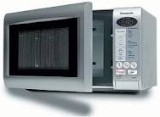
Cooking Facilities
The 2012 edition has new sections on cooking equipment which is focused towards nursing homes.
Section 19.3.2.5.2 allows residential cooking equipment that is used for food warming or ‘limited cooking’ not to have to comply with NFPA 96 (such as exhaust hoods), and the area is not considered a hazardous area

Slide 67
Cooking Facilities
Other new sections permit small cooking areas that are limited to preparing meals for no more than 30 persons to either be open to the corridor, or not be required to comply with NFPA 96
However, there are heavy restrictions on how the cooking equipment is arranged and used.

Slide 68
Action Required to Comply:
This change on cooking facilities in the 2012 LSC was made for the benefit of nursing homes and long term care facilities
The change was made in the healthcare occupancy chapter so it does apply to hospitals, although it is not expected that hospitals would be interested in this change

Slide 69
Alcohol Based Hand-Rub Dispensers
Section 19.3.2.6 is a new section on ABHR dispensers which was not in the 2000 edition
Aerosol foam dispensers limited to 18 oz. are now permitted
The ABHR solution is not permitted to exceed 95 % alcohol content by volume

Slide 70
Alcohol Based Hand-Rub Dispensers
Additional changes on ABHR dispensers…
One dispenser located inside a patient room or suite is not included in the aggregate total per smoke compartment
Dispensers are required to have 1 inch clearance, side-to-side and not allowed to be mounted over ignition sources

Slide 71
Alcohol Based Hand-Rub Dispensers
Section 21.3.2.6 now allows ABHR dispensers in corridors of Ambulatory Care Occupancies

Slide 72
Action Required to Comply:
However, there is still nothing in Chapter 39 that would permit ABHR dispensers in Business Occupancies
In fact, section 8.7.3.2 prohibits flammable liquids in locations that would jeopardize egress

Slide 73
Automatic Sprinklers
We all know that new healthcare construction must be protected with automatic sprinklers. Previously in the 2000 edition, existing healthcare occupancies only had to be protected by sprinklers if they met the following parameters:
If the Construction Type required it
If the facility was being renovated or remodeled, then just the renovated area had to be sprinklered

Slide 74
Automatic Sprinklers
Now, there are new sections of the existing healthcare chapter that requires sprinklers in existing facilities:
19.3.5.1 requires existing nursing homes to be fully protected with sprinklers (Certain areas of Type I and Type II Construction facilities are permitted to have alternative measures)
19.3.5.2 (and 19.4.2) requires existing high-rise healthcare occupancies to be fully protected with automatic sprinklers within 12 years of the adoption of the 2012 edition (Includes hospitals as well as nursing homes)

Slide 75
Automatic Sprinklers
A high-rise facility is defined as:
“A building where the floor of an occupiable story is greater than 75 feet above the lowest level of fire department vehicle access.”
Check your facility to see if it is considered a high-rise facility.

Slide 76
Action Required to Comply:
Fully protected with sprinklers means all accessible spaces must be sprinklered, including these often overlooked areas:
Building over-hangs
Walk-in coolers and freezers
Atriums (with some exceptions)
Closets (with some exceptions)
Storage areas

Slide 77
Action Required to Comply:
CMS has requested in-put on the 12-year rule for existing high-rises facilities to be sprinklered
The final rule may require the installation of sprinklers sooner, so start the budget process today

Slide 78
Fireplaces
Section 19.5.2.3 now allows fire places in new areas of the healthcare facility
Direct-vent gas fire places are permitted inside smoke compartments containing patient sleeping areas, provided:
They are not located inside patient sleeping rooms
The smoke compartment must be fully protected with automatic sprinklers
Fireplace must have a sealed glass front
Carbon monoxide detectors must be placed in the room with the fireplace

Slide 79
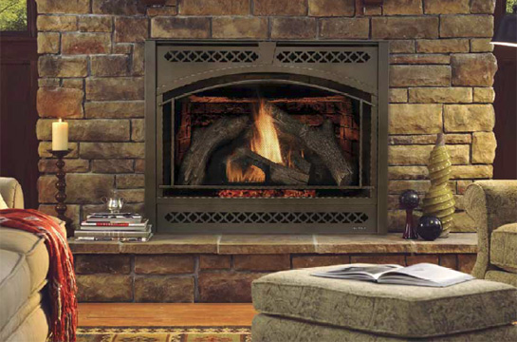
Fireplaces
Section 19.5.2.3 now allows solid fuel-burning fireplaces in areas other than patient sleeping areas
Solid fuel-burning fireplaces must be separated from patient sleeping areas by a 1-hour fire rated barrier
Must comply with applicable NFPA standards (see 9.2.2)
Carbon monoxide detectors must be placed in the room with the fireplace

Slide 80
Action Required to Comply:
Solid fuel fire places is a great risk for infection control issues, as well as creosote condensation on the chimney
It is best to use a clay or ceramic tile chimney rather than a steel chimney for solid fuel fire places

Slide 81
Operating Features
The 2000 LSC had this requirement for combustible decorations:
Combustible decorations are not permitted unless they are flame-retardant or have been treated with approved fire-retardant coatings

Slide 82
Operating Features
Section 19.7.5.6 has new requirements for decorations in healthcare occupancies
Combustible decorations that meet the requirements of NFPA 289 and NFPA 701 are permitted
Photographs, paintings and ‘other art’ may be directly attached to walls or non-fire rated doors, provided it does not interfere with the operation of the door

Slide 83
Operating Features
New requirements for decorations:
Combustible decorations (photographs, paintings) may not exceed 20 percent of the wall and ceiling area in non-sprinklered smoke compartments

Slide 84
Operating Features
New requirements for decorations:
Combustible decorations may not exceed 30 percent of the wall and ceiling area in a sprinklered smoke compartment
Combustible decorations may not exceed 50 percent of wall and ceiling area inside patient sleeping rooms having a capacity not exceeding 4 persons, in a sprinklered smoke compartment

Slide 85
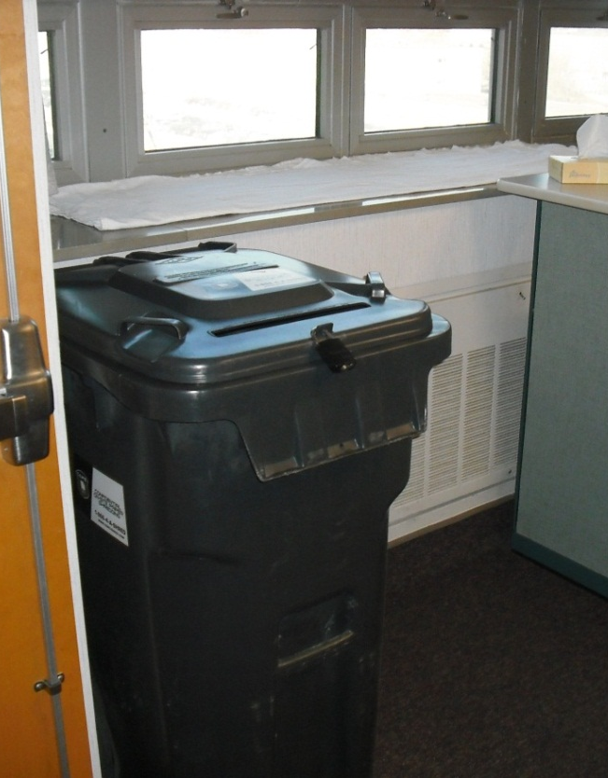
Operating Features
Containers for documents waiting to be shredded were required to be stored in a hazardous room if they exceeded 32 gallons
This is a picture of a 96 gallon capacity container and was a common sight

Slide 86
Operating Features
Section 19.7.5.7.2 has new requirements for containers used for recycling clean waste and/or patient records
Containers must be labeled and listed as meeting FM Approval Standard 6291, or similar approval
Containers up to 96 gallons capacity are not required to be stored in a hazardous room

Slide 87
Action Required to Comply:
Combustible Decorations…
Identifying the area for the 20% and 30% wall and ceiling areas may be challenge
Areas separated by barriers (doors) have to be considered separate area
Make sure the clean waste/patient records container meets the requirements listed
[“Clean waste” means clean waste!]

Slide 88
Sprinkler System Testing
NFPA 25 Standard for the Inspection, Testing and Maintenance of Water-Based Fire Protection Systems, 2011 edition is referenced by the new 2012 LSC.
Water-flow switches that are vane-actuated or pressure-switch type are now permitted to be tested semi-annually, instead of quarterly.

Slide 89
Sprinkler System Testing
Electric motor-drive fire pumps will now be allowed to be tested on a no-flow basis (churn) monthly, instead of weekly.
Diesel driven fire pumps still have to be tested weekly.

Slide 90
Action Required to Comply:
No real down-side on this change. Should save time and resources in testing requirements
Make sure all NFPA 25 requirements are complied with in regards to testing procedures for water-flow switches and fire pumps

Slide 91
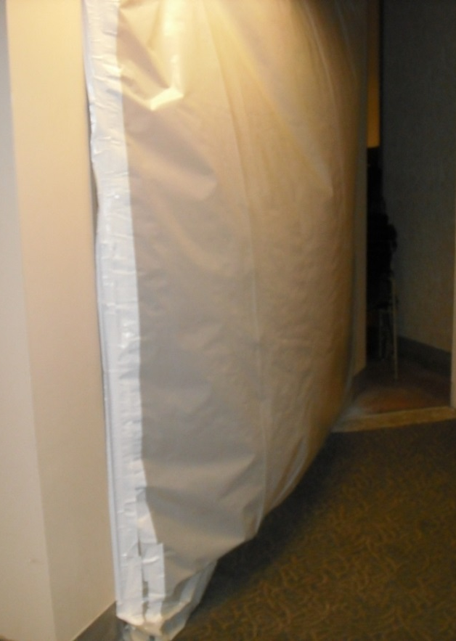
Temporary Construction Barriers
NFPA 241 Standard for Safeguarding Construction, Alteration, and Demolition Operations (2009 edition) is referenced by section 19.7.9.2 for temporary construction barriers.

Slide 92
Temporary Construction Barriers
This new edition of NFPA 241 will require 1-hour fire rated barriers between construction areas, and occupied areas if the construction area is not protected with automatic sprinklers.
Plastic ‘tarps’ will not be permitted as barriers for sprinklered construction areas, even if they are fire retardant.

Slide 93
Action Required to Comply:
It is unclear how CMS and the accreditation organizations will enforce this issue
This requirement will be a greater burden on hospital construction projects
The best approach is to install temporary upright sprinkler heads in your construction areas as soon as the ceiling is demolished

Slide 94
Generator Testing
If your monthly generator load test does not meet the 30% capacity of the nameplate rating, then an annual load test is required.
The new 2010 edition of NFPA 110 which will be referenced by the 2012 LSC only requires a 90-minute load test, rather than a 2-hour load test.

Slide 95
Generator Testing
The new annual test will begin at 50% load for 30 minutes, then move to 75% load for 60 minutes, for a total of 90-minutes of continuous test.
No longer required is the 25% load for 30 minutes.

Slide 96
Action Required to Comply:
This change was made when the technical committee for NFPA 110 determined that there was no value in testing a generator for 30 minutes at 25% load

Slide 97
CMS Categorical Waivers
CMS has issued categorical waivers to allow certain sections of the 2012 Life Safety Code to be used now, without having to submit any documentation to implement the use of the waivers.
These are available for you to use now, provided you meet the requirements of the waiver, the requirements of your accreditation organization, and the 2012 LSC section that the categorical waiver refers to.

Slide 98
CMS Categorical Waivers
S&C memo 10-04 (10/30/09)
Allows hospitals to use the NFPA 6-year damper testing interval
S&C memo 12-21 (3/9/12)
Allows certain items to be left unattended in the corridor
Allows kitchens to not be considered a hazardous area
Allows changes with fireplaces
Allows combustible decorations

Slide 99
CMS Categorical Waivers
S&C memo 13-25 (4/19/13)
Allows a lower humidity setting of 20% rh in anesthetizing locations (but subsequent S&C memo requires a risk assessment to ensure equipment and supplies can tolerate the lower humidity levels)
S&C memo 13-58 (8/30/13)
Allows changes to med gas alarms
Allows existing openings to unoccupied rooms in exit enclosures
Allows a reduction of the annual test of generators

Slide 100
CMS Categorical Waivers
Allows locking doors for infant security
Allows more than 1 delayed egress locked door in the path of egress
Allows changes to suites
Allows reduction in testing of waterflow switches and non-flow fire pump testing
Allows clean waste recycling containers
S&C memo 14-46 (9/26/14)
Allows power strips in anesthetizing locations and patient care areas

Slide 101
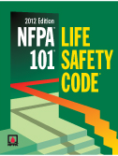
In Conclusion…
With the adoption of the 2012 edition of the Life Safety Code there will be many changes.
Don’t wait… Start today in your process in becoming prepared.

Slide 102
Questions…?
That concludes this presentation….
Are there any questions?

Slide 103
Thank You!
Changes With the New 2012 Life Safety Code
Brad Keyes, CHSP
Keyes Life Safety Compliance, LLC
brad@keyeslifesafety.com

